Slide 1
Action Research
Dr. Bidulata Sahoo
Asst.Prof. (Teacher Education)
Shailabala Women’s Auto College, Cuttack

Slide 2
Introduction:
Term was coined by Kurt Lewin in 1940.
Stephen M.Corey first used ‘Action Research’ in the field of Education.
Action research is a type of applied research.
It is a small-scale intervention.
It helps teacher to know their students well, interact with them, observe them and gather data.

Slide 3
Definition
“On the spot research aimed at the solution of an immediate problem”-Mouly
“Action research is research used by teachers, supervisors and administrators to improve the quality of their decisions and actions”-Good
Action research is focused on the immediate application, not on the development of theory . It has placed its emphasis on real problem here and now in a local setting-J.W. Best

Slide 4
Cont…
Action research is a fancy way of saying let’s study whats happening at our school and decide how to make it better place.
- Emily Calhoun
Action research is a research used by teachers, supervisors and administrators to improve the quality of their decision and action.
- Good

Slide 5
Characteristics
It is situational or contextual
It is reflective
It is based on scientific approach
It is small scale intervention
It is a way to find solutions to overcome obstacles in learning
It is self evaluative
It is unified exercise to fill a gap between theory and practice

Slide 6
Cont.....
It is a way to develop self confidence in teacher researcher.
It empowers and motivates teachers
It may be a single teacher research or cooperative
Focus on immediate problem and solution
Aims to improve practice of work condition

Slide 7


Slide 8
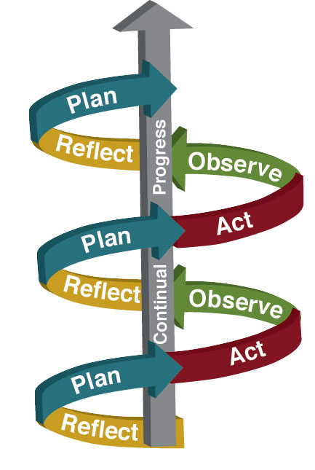

Slide 9
Scope/Areas of Action Research:
Curricular planning and course material development.
Teaching practices
Programme delivery and learning strategies.
Student assessment and evaluation
Staff development
Management and administration
Behavioural problems.
Co-curricula Activities

Slide 10
Class room Action Research???
It begins with a question about classroom experiences, issues, and challenges. It is a reflective process which helps teachers to explore and examine aspects of teaching and learning and to take action to change and improve
Purpose of CRAR:
Create healthy classroom atmosphere
Facilitate better teaching learning
Maximum students welfare

Slide 11
Why Action Research ???
Professionalize teaching.
Enhance the motivation and efficacy of a weary faculty.
Meet the needs of an increasingly diverse student body.
Achieve success with “standards-based” reforms.

Slide 12
Types of Action Research:
Individual Action Research
Collaborative Action Research
School-wide Action Research
Areas of Action Research for teachers:
School based curriculum development
Professional development
Systems planning
School reconstructing
As an evaluative tool

Slide 13
Steps :
Identifying a problem
Reviewing literature
Planning
Collecting data
Analyzing data
Taking action
Evaluating
Reflecting
Improving

Slide 14
How to write references:
Author name
Year of publication
Article title
Available from: URL
Date of Access

Slide 15
Thank you

