Slide 1

Classroom Management SkillS
Dr. Bidulata Sahoo
Asst. Prof. Teacher Education
SBWAC, Cuttack

Slide 2


Slide 3


Slide 4


Slide 5


Slide 6
Why Classroom Management
For proper execution of curriculum development.
Orderly learning Environment.
Helps in developing best teaching practices and putting them into action.
Enhances academic skills and competencies in students
Social and emotional development

Slide 7
What it is ???
Classroom Management is a term used by teachers to describe the process of ensuring that classroom lessons run smoothly despite disruptive behaviour by students.
It is a way of organizing the resources, pupils and helpers so that the teaching and learning can process in an efficient and safe manner.

Slide 8
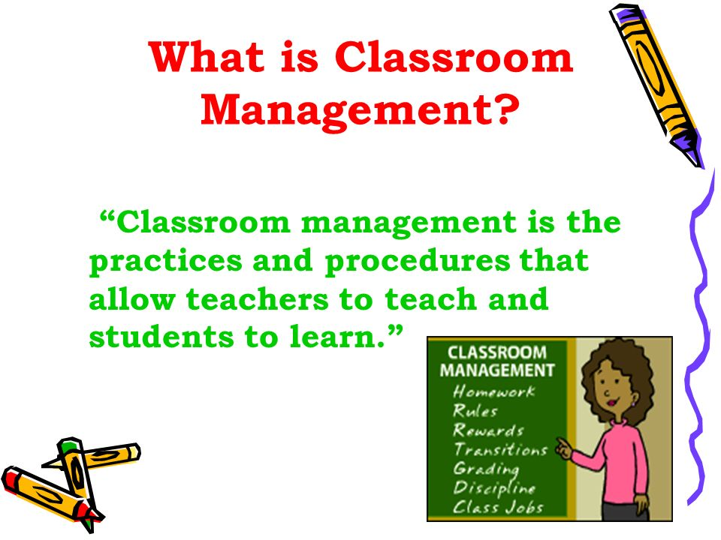

Slide 9
Classroom management
It refers to :
Creating a safe, comfortable and inclusive environment for students learning.
It facilitates building a strong positive relationship with and among learners
It promotes love for learning and success.

Slide 10
Cont….
It is motivating your students
It is building your student’s self esteem
It is effective discipline
It is being prepared for class
It presents engaging instructions to the learners.

Slide 11
Characteristics of a well managed class:
Students are deeply involved with their works.
Students know what is expected of them and are generally successful
There is relatively little wasted time, confusion or disruption.
The climate of the classroom is work oriented, but relaxed and pleasant.

Slide 12
Room Arrangement
Congestion free in walking areas
All students can see every teacher
Teacher can see every student
Teaching materials, student supply in accessible range
Student arrangement for whole/large group.
Student arrangement for small group.

Slide 13
Time Management:
Kauchak and Eggen (2008) categorize class time into four types
Allocated time
Instructional time
Engaged time
Academic learning time

Slide 14
Common classroom strategies
Model Behaviour
Know your subject well
Create a class character
Try positive reinforcement as opposed to negative
Praise
Build excitement in your classroom.
Build strong relationships with your students
Make a note of the class rules
Give out rewards for good behaviour
Look out for all different types of learners

Slide 15
5 Ps for classroom management:
Prompt
Prepared
Productive
Polite
Position

Slide 16
Materials
Instruction
Policies and procedure
Time
Behaviour
Layout

Slide 17
Effective teachers are ready
They have the room ready !
Positive work environment that is work oriented
They have the work ready !
Desks, books, papers, assignments and materials
They have themselves ready!
Warm, positive attitude and positive experiences

Slide 18
“Being an effective class manager is not a talent which some people just have and others do not
It is a set of skills and an attitude learned through patience and practice”

Slide 19
Any Questions
???

Slide 20
Thank you

