Slide 1
Healthy Foods For Healthy Life

Slide 2
By:- Asso. Prof. Smt Indurekha Mohapatra
HoD of PG Department of Homescience
Shailabala Women's Autonomous College

Slide 3

What is health?
Health is a state of complete physical mental and social well being.
A person is said to be healthy when he/she is free of any type of disease (infectious/deficiency), when he/she is mentally happy and healthy and when his/her social relationships are healthy in a society.
Hence, to have a healthy life one has to be physically, mentally and socially complete.

Slide 4

What is Food?
The eatable substances eaten by humans and other animals to get energy for various activities for growth and development is called food.

Slide 5
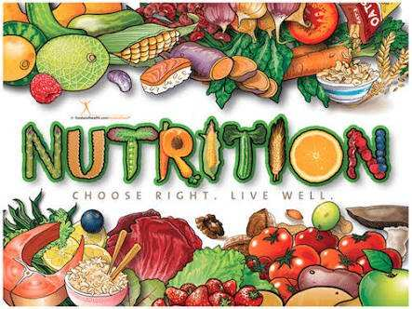
Nutrition:-
Nutrition is defined as the science of food and its relationship to health.
It is food at work in the body.
It includes everything that happens to food.

Slide 6
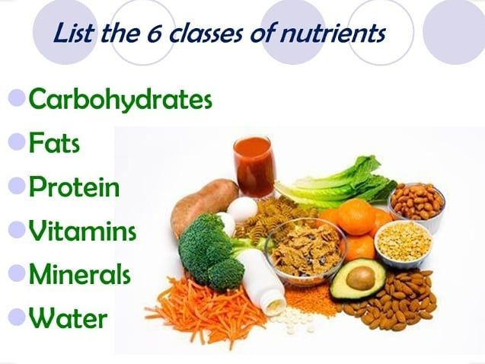
Nutrients:-
Nutrients are the compounds in food that provide us with energy that facilitates repair and growth and helps to carry out different life processes.

Slide 7
Nutritional status:-
Nutritional status was defined as “a physiological state of an individual, which results from the relationship between nutrient intake and requirements, and from the body's ability to digest, absorb and use these nutrients”

Slide 8
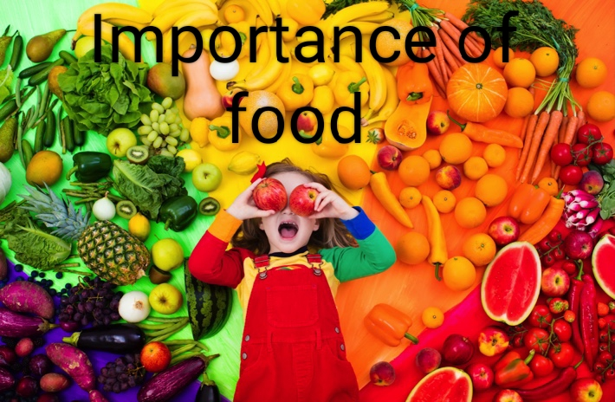
Importance of food
1. We need food to live.
2. What we eat matters.
3. Preparing food has an impact on mental health.
4. Many people have a complicated relationship with food.
5. Food insecurity is a major issue.
6. Many livelihoods are tied to food.
7. Climate change is affecting food.
8. Food is culture.

Slide 9
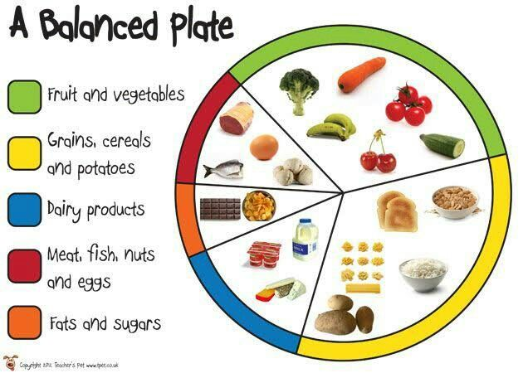
Balanced diet:-
A balanced diet is one that contains all of the essential elements that the human body needs. Carbohydrates, lipids, vitamins, minerals, proteins, fiber and water are all essential components in a well-balanced diet. A nutritious, well-balanced diet lowers the risk of disease and enhances general health.

Slide 10
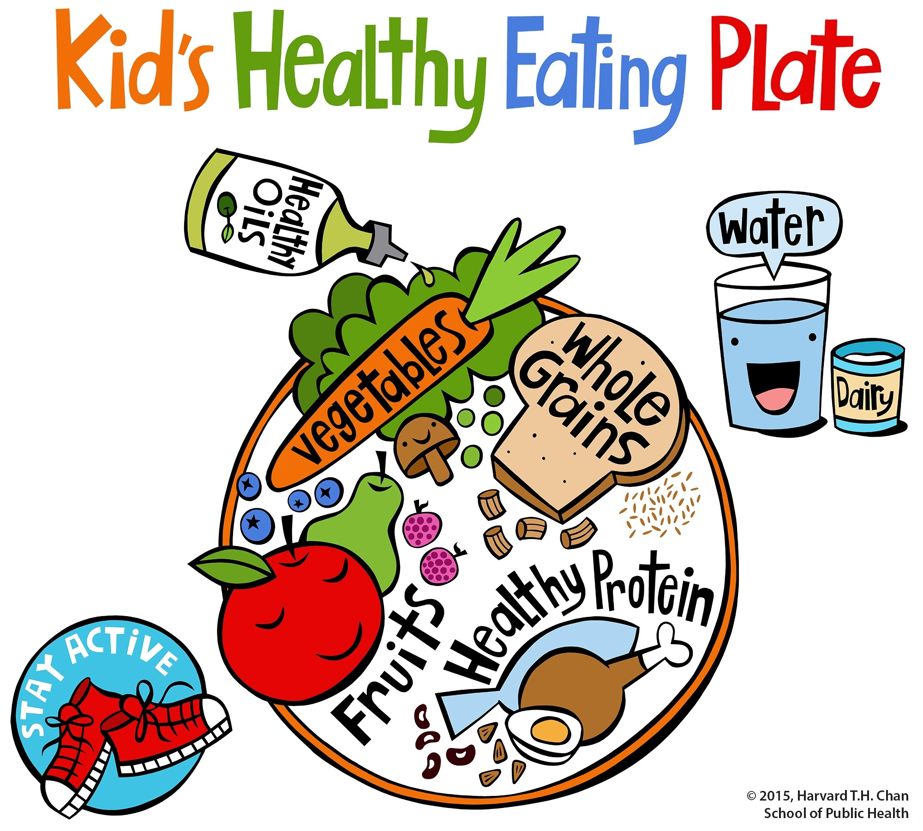
Healthy food:-
Healthy foods are those that provide you with the nutrients you need to sustain your body's well-being and retain energy. Water, carbohydrates, fat, protein, vitamins, and minerals are the key nutrients that make up a healthy, balanced diet

Slide 11
Continuation:-
A healthy diet helps to protect against malnutrition in all its forms, as well as noncommunicable diseases (NCDs), including diabetes, heart disease, stroke and cancer.
Unhealthy diet and lack of physical activity are leading global risks to health.
Healthy dietary practices start early in life – breastfeeding fosters healthy growth and improves cognitive development, and may have longer term health benefits such as reducing the risk of becoming overweight or obese and developing NCDs later in life.

Slide 12
Myths and Facts About Healthy Eating:-
Myth: Eating at Night Causes Weight Gain
Fact: The answer is complex because it depends on your personal eating habits. In theory, as long as you don’t exceed your daily caloric intake (no matter when you eat), you shouldn’t gain weight. However, nighttime eating tends to be more complicated.

Slide 13
Continuation:-
Myth: Multi-Grain Breads are Healthier Than White Breads
Fact: Multi-grain breads may sound healthy because you more than likely have been taught to look for “multi-grain” labels, but multi-grain breads aren’t as healthy as you may think. Food companies use various refined grains to create some multi-grain breads, filtering out key nutrients in the process, which is what happens during the manufacturing of white breads.

Slide 14
Continuation:-
Myth: Diet Soda is Better Than Regular Soda
Fact: It’s true that diet soda contains fewer calories than regular soda, and at first glance, diet soda seems like a good alternative if you’re managing your weight and dental hygiene. However, there are many more hidden and harmful ingredients in diet soda than one may think.

Slide 15
Do's and Don'ts of healthy eating habits
Do's
1. Eat two or three meals each day.
2. Eat breakfast every morning.
3. Make breakfast your heaviest meal for the day and dinner the lightest meal for the day.
4. Eat fruits, grains and nuts in the morning for your breakfast and vegetables, gains and nuts in the evening for dinner.
5. Eat your last meal before it reaches 6.0.Clock.
6. Eat slowly and chew your food properly.
7. Drink a lot of water between meals.

Slide 16
Continuation:-
Don'ts
1. Don't over eat or eat too much at one meal.
2. Don't eat too much of the refined products, including white rice and flour.
3. Don't eat certain fruits and vegetables at the same meal.
4. Don't eat and drink at the same time.
5. Don't eat too late in the evening. Avoid this if... possible.
6. Don't eat too much spicy foods.
7. Don't drink anything that has been fermented.

Slide 17
Thank you

