Slide 1
A JOURNEY OF
VISUALLY CHALLENGED FROM INCLUSION TO
SUPER INCLUSION IN ODISHA
Submitted by
Girish Chandra Behera,
Assistant Professor,
Teacher Education, Odia,
SHAILABALA WOMEN’S (AUTO)College, Cuttack,
Phone :-9861197886

Slide 2
Introduction
Once upon a time, Blindness was a crisis and now a challenge. Over coming the effects of visual impairment was once a dream and now a reality. The age of deprivation is over. The age of myths and superstition is gone. The society has change its attitude towards the disabled people. Science has empowered them to go on a journey of success. Now they demand their rights not charity. Education is a driving force to direct they are journey from inclusion towards super inclusion. The people of Odisha feel proud of them, who consider their lives as an adventure and loss of one sense is no bar to success.

Slide 3
Objectives of Super Inclusion
1:- To understand the process of super inclusion,
2:- To understand the needs of super inclusion,
3:- To make the community a part of super inclusion,
4:- To inculcate the values of super inclusion,
5:- To encourage the social activities of super inclusion,
6:- To involve the corporate sector in the inclusive development process,
7:- To explore the rural talents with disability,
8:- To change the attitude of the common people towards persons with disabilities,
9:- To promote the PWDs equal Participation in the national development,
10:- To make further research in super inclusion.

Slide 4
What is Super Inclusion??
Super inclusion is a state of achievement, where the society demands and the differently empowered people fulfil the needs of the society. Super inclusion is a prestigious position, where the differently abled talents successfully pay up the social debt utilizing their human resources to the best of their capacities. Super Inclusion is the social mind set, to accept and respect the productive citizenship of the people with special needs. It is a spec horizon social change, shifting from inclusion to super inclusion.

Slide 5
The secret of super inclusion
Odisha has a glorious history of educating visually challenged for last 6 decades. After the Sarva Shiksha Abhiyan came into force, almost all the general school teachers have been trained in handling children with visual impairment in our state. Odisha has given appointment to approximately 500 trained teachers with visual impairment in different general schools of the state. It’s a reflection of super inclusion and good governance in the state. Our state has recruited around 100 lecturers/college teachers in various subjects and in different colleges of Odisha. The doors of Odisha civil service, Odisha educational service are open for the visually challenged aspirants to prove their excellence in these fields of social commitment. It’s a matter of pleasure that our state is witnessing differently abled candidates qualifying for these administrative and educational services from time to time.

Slide 6
Measure steps for super inclusion
1:-Recognising the talents,
2:-Ensuring complete medical rehabilitation,
3:-Initiating educational rehabilitation,
4:-Promoting educational guidance and career counselling,
5:-Training on ICT,
6:-Training on orientation and mobility,
7:-Promoting professional exposure at grass root level.

Slide 7
Principles of Super Inclusion
1:- Total acceptance of persons with special needs,
2:- Creating a Co-operative working environment in the society,
3:- Following the principles of division of labour,
4:- Removing the existing barriers of communication,
5:- Use of information technology in an accessible format,
6:-Recognising their positive and productive performance,
7:- Providing the best professional exposure of the field concerned.

Slide 8
Determinants of Super Inclusion
Let’s have a focus on the determinants of super inclusion as follows.
A. Individual attempt with social acceptance,
B. Self confidence with social recognition,
C. Individual skill development with community support,
D. Individual empowerment with professional guidance,
E. Individual success with equal Participation.

Slide 9
Innovative practices for super inclusion
(I) Integrated Workshop
Integrated workshop is an innovative Workshop which gives placements for both to the persons with disabilities and non disabled workers to work together under 1 roof . there is a scope of division of labour to contribute for the work in an entrepreneurship. It follows the principles of interdependence to complete a task in a Co-operative environment.
(ii) Job identification workshop
It is the need of the hour to organise job identification workshop to prepare a fresh least of identified jobs which can be well performed by the skilled visually challenged workers which would include technical exports from different IIT special educators curriculum Exports and social activists.

Slide 10
(iii) Integrated marriage Initiatives
Social activists should come forward to conduct integrated marriage ceremonies among the interested couples , where either of the couple is a spouse with disability. This is highly encouraged by the government of Odisha providing an incentive of rupees 2.5 lakhs to each couple registered under the particular excellency.
(iv) Centres of excellence
There should be centres of excellence at each district headquarter of the state to prepare the excellent and exemplary persons with disabilities to lighten the society with their inward vision and excellence .

Slide 11
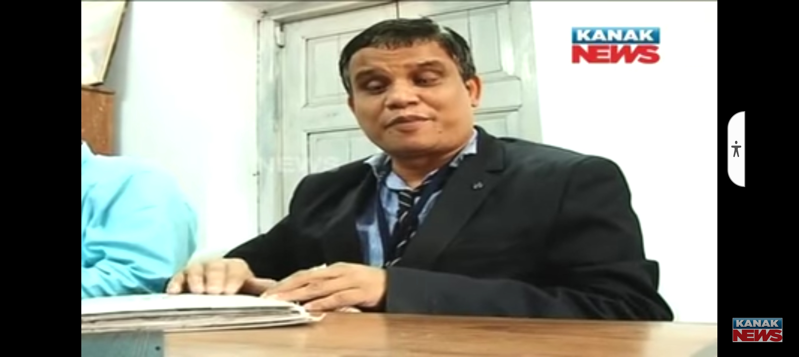
Bright Examples of Super Inclusion
Sannyas Kumar Behera
The First OAS Officer in Odisha from VI Community

Slide 12
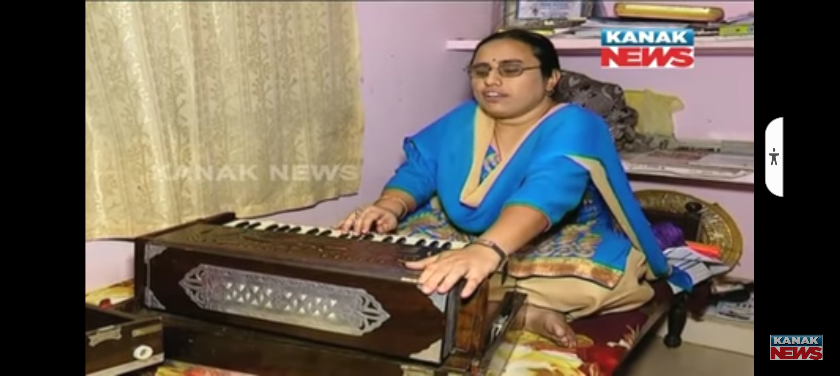
Bijaya Laxmi Pal
The First OES Officer School Branch
from VI Community

Slide 13
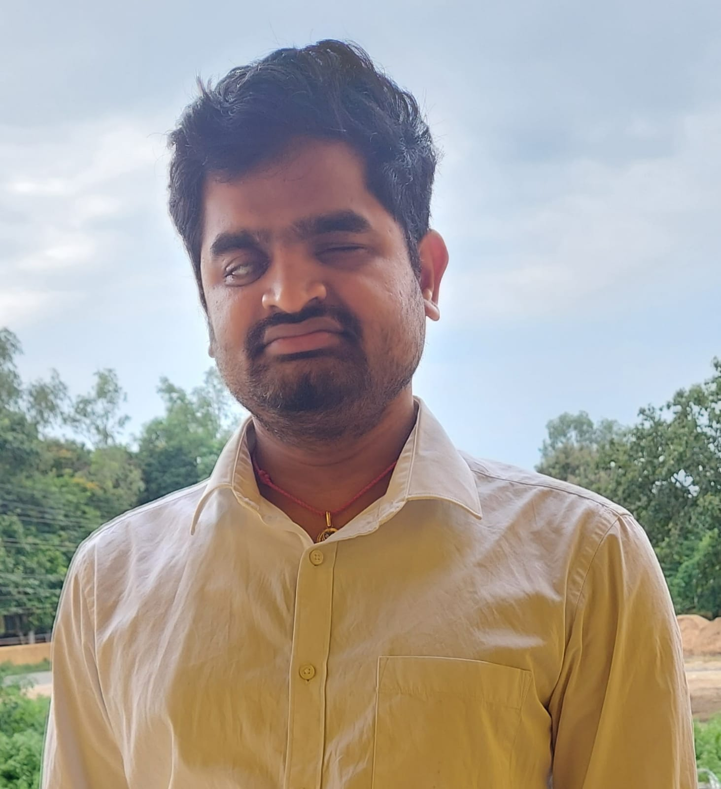
Ananta Nayak
Assistant Registrar
Co-operative Society

Slide 14
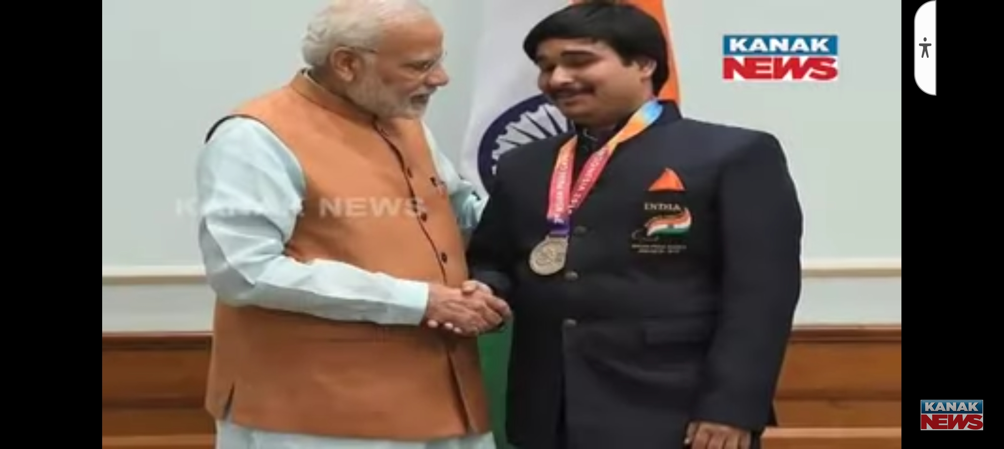
Prachurya Pradhan
An OAS Officer & International Chess Player

Slide 15
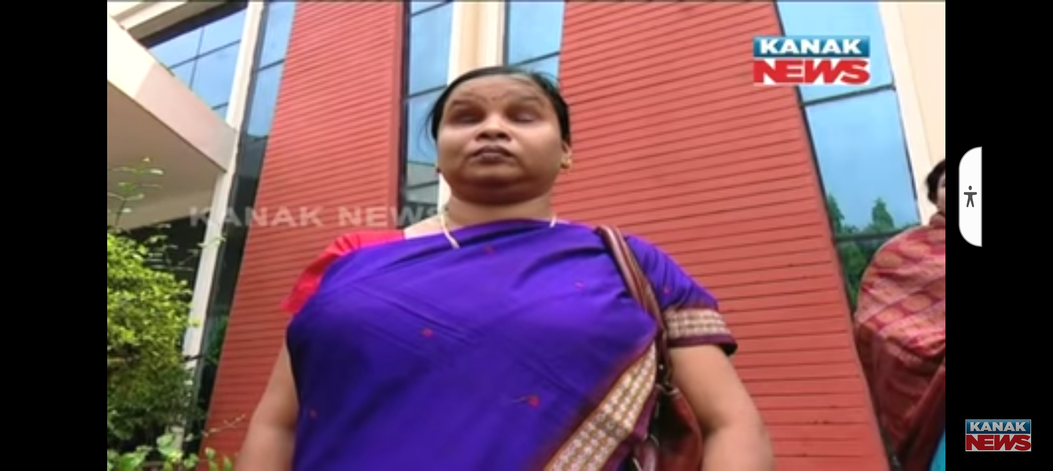
Manjulata Panda
First Girl with PHD
from VI Community

Slide 16
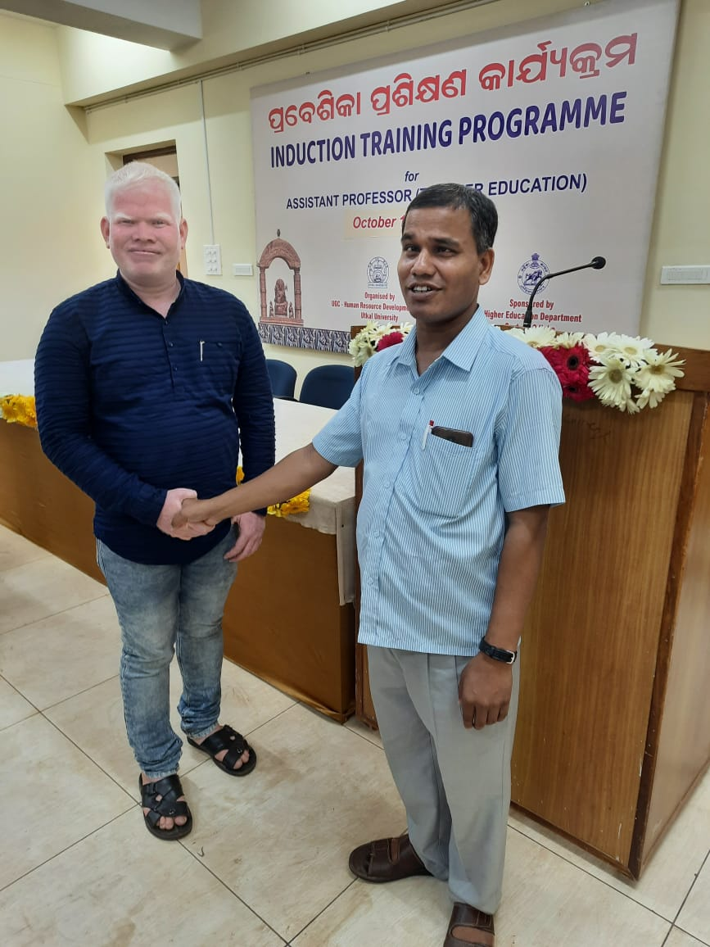
Girish Chandra Behera &
Rajiv Lochan Sahoo
Assistant Professor Teacher Education Odia

Slide 17
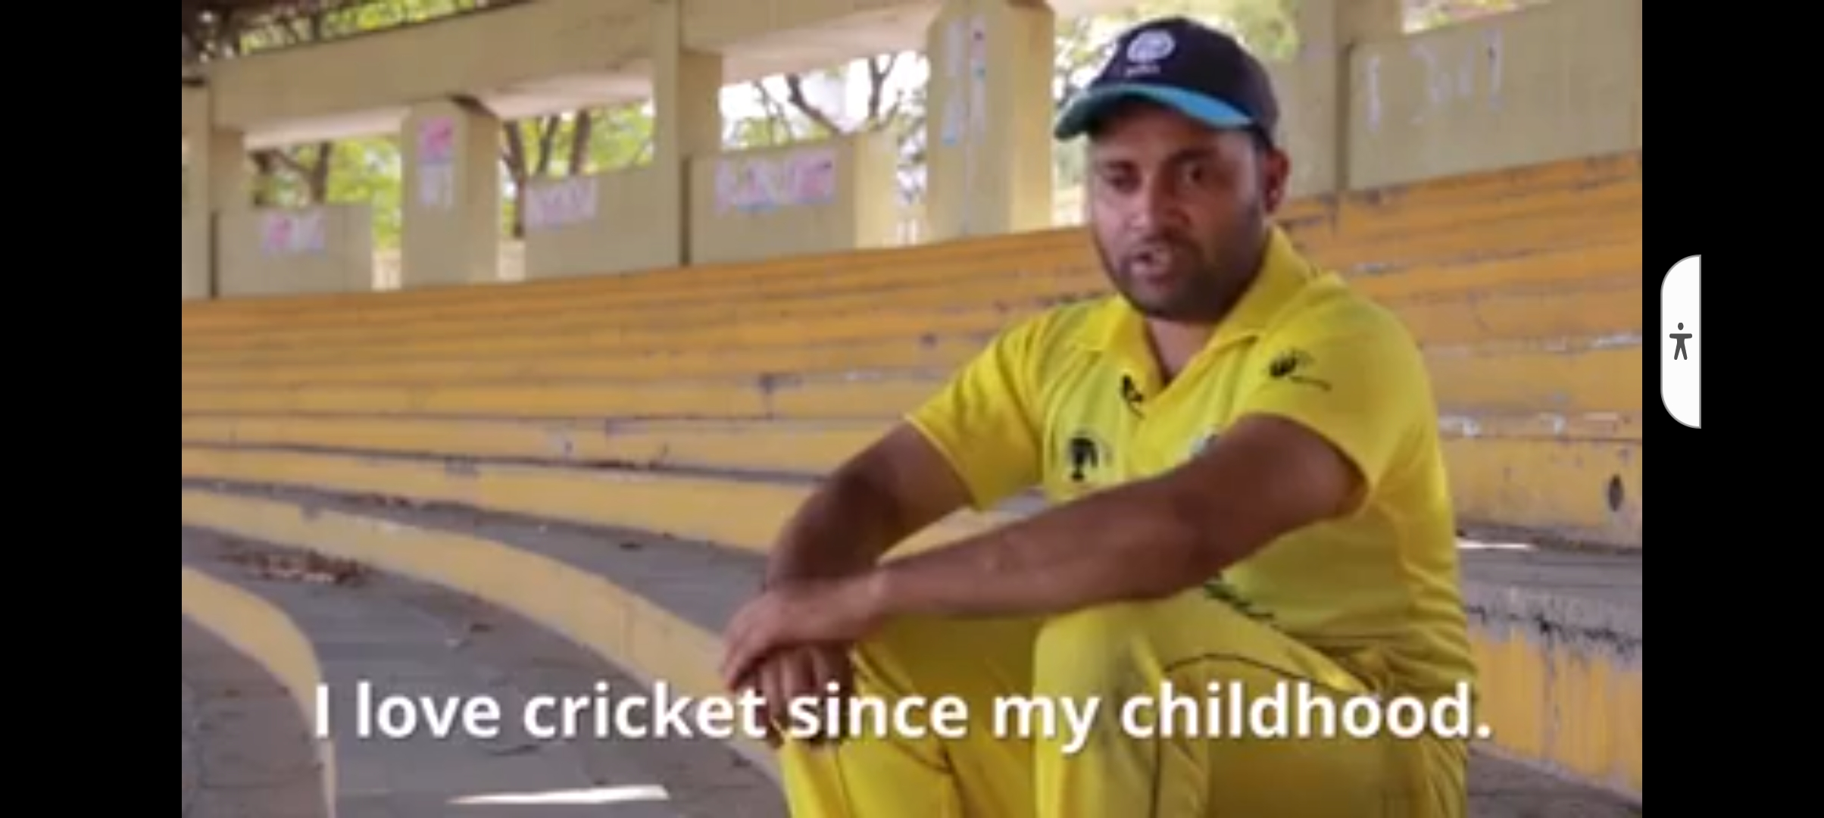
Mahmood Jafar Ekbal
The Captain
of Indian Cricket Team (VI)

Slide 18
Conclusion
Super inclusion is a new vision to optimise the empowerment of persons with disabilities. It is an attempt to accept and respect the interdependence of the disabled and non disabled people in the society. It is the highest realization of an inclusive society. Super Inclusion is not just a miracle rather a scientific reality. Let all the academicians, educationists, researchers, social activists and talented persons with disabilities join their hands together to achieve and accelerate the process of super inclusion for the greater interest of the nation .

Slide 19
List of Key Words
Career Counselling – Support to choose a suitable profession.
Educational Guidance – Assisting an individual to reach optimum educational development.
Empowerment- Capacity to earn and serve others.
Inclusion- living and learning together.
Super Inclusion- A highly secured position to fulfil the needs of the community.
Visually Challenged The people who take the absence of vision as a challenge in life.
Rehabilitation- An act of repairing and compensating any loss.

Slide 20
References
1.National education Policy 2020,
2. Inclusive education in india,
3. www.SSEPD.nic.in ,
4. Success stories of Visually challenged .
***THE END ***

