Slide 1

LIPIDS-BASIC SKETCH
PART : 1
Khusbu Agarwal
Assistant Professor In Botany
SBWC, Cuttack

Slide 2
Lipids may be regarded as organic substances relatively insoluble in water, soluble in organic solvents (alcohol, ether etc.), actually or potentially related to fatty acids and utilized by the living cells.
Unlike the polysaccharides, proteins and nucleic acids, lipids are not polymers. Further, lipids are mostly small molecules.

Slide 3
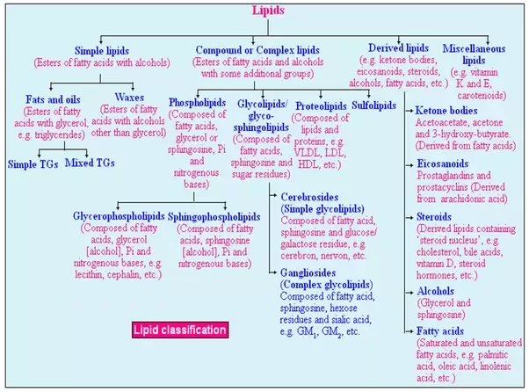

Slide 4
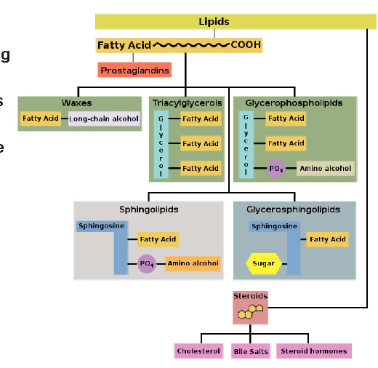

Slide 5
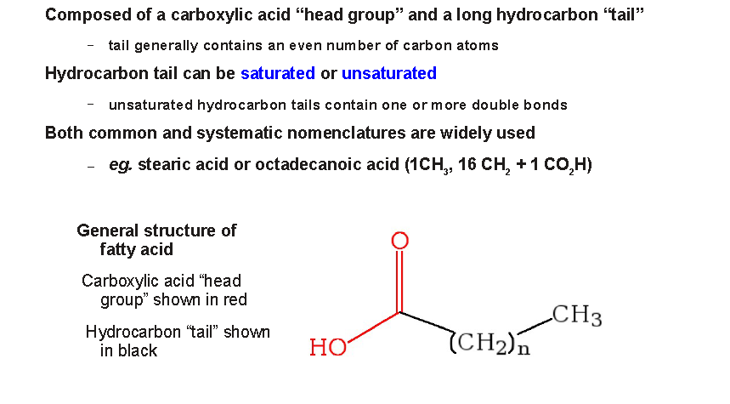
Fatty Acids
Fatty Acids- Building blocks of lipids

Slide 6
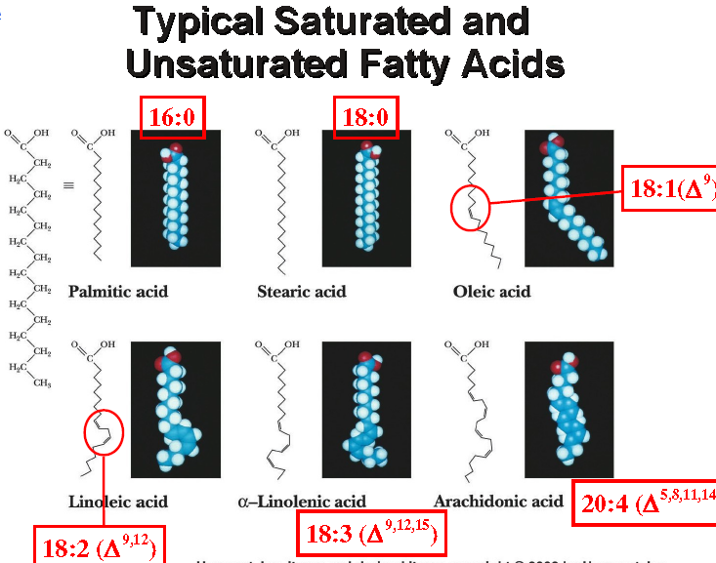

Slide 7
Even and odd carbon fatty acids
Most of the fatty acids that occur in natural lipids are of even carbons (usually 14C-2OC).
This is due to the fact that biosynthesis of fatty acids mainly occurs with the sequential addition of 2 carbon units.
Palmitic acid (l6C) and stearic acid (l8C) are the most common.
Among the odd chain fatty acids, propionic acid (3C) and valeric acid (5C) are well known.

Slide 8
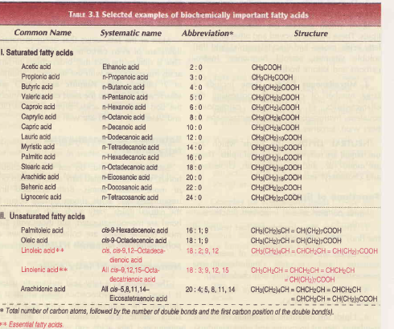
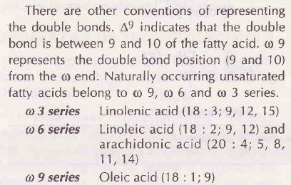
Nomenclature of fatty acids
saturated fatty acids end with a suffix -anoic (e.g., octanoic acid)
unsaturated fatty acids end with a suffix –enoic (e.g., octadecanoic acid)
total number of carbon atoms are written first, followed by the number of double
bonds and finally the (first carbon) position of double bonds, starting from the carboxyl end.
Thus, saturated fatty acid, palmitic acid is written as l6:0, oleic acid as 18:1;9, arachidonic acid as 20 : 4; 5, 8, 11, 14.

Slide 9
Triacylglycerol
Khusbu Agarwal
Assistant Professor In Botany
SBWC, Cuttack

Slide 10
Most abundant lipids comprising 85-90% of body lipids
Triacylglycerols (formerly triglycerides) are the esters of glycerol with fatty acids.
The fats and oils that are widely distributed in both plants and animals are chemically triacylglycerol.
They are insoluble in water and non-polar in organic solvents.
Character and commonly known as neutral fats.
Fats as stored fuel
Fats primarily occur in adipose tissue

Slide 11
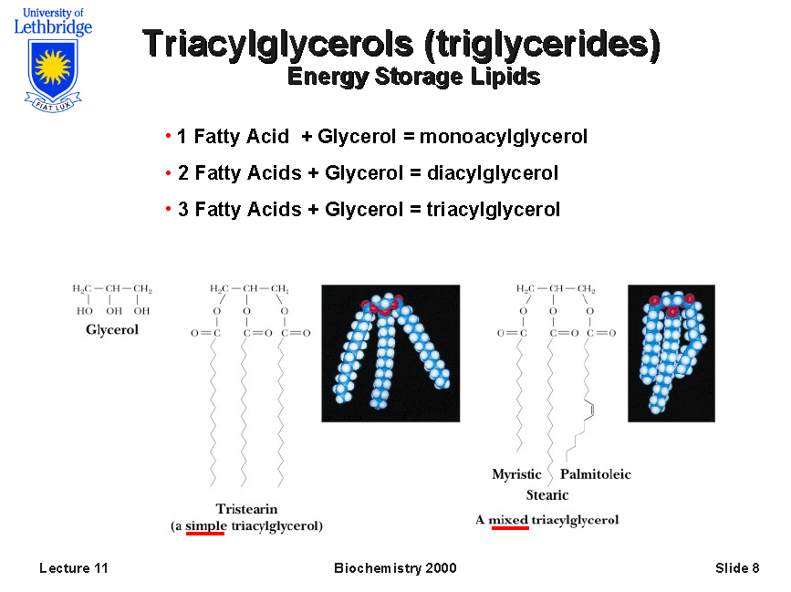

Slide 12
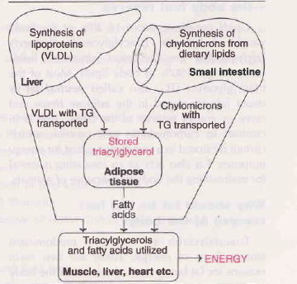
Biosynthesis and Breakdown
The triacylglycerols transported from intestine (as chylomicrons) and liver (as VLDL) are stored in the adipose tissue.
Besides, they are also utilized by muscle, liver, heart etc., as per the needs of the body.

Slide 13
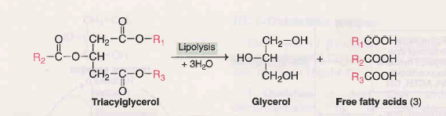
Mobilization of tat from adipose tissue
The completed degradation of triacylglycerol to glycerol and free acids is known as lipolysis
enzyme namely hormone sensitive triacylglycerol lipase, removes the fatty acid either from carbon 1 or 3 of the triacylglycerol to form diacylglycerol.
The other two fatty acids of TC are cleaved by additional lipases specific for diacylglycerol and monoacylglycerol

Slide 14
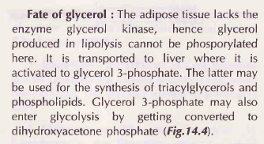
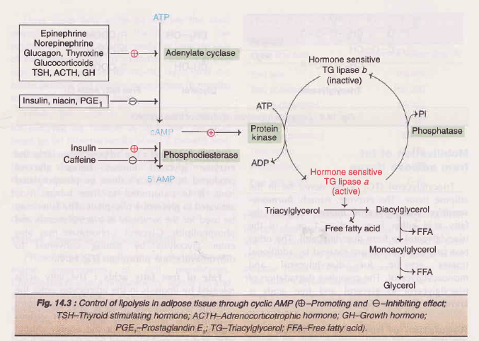
Mobilization of tat from adipose tissue
The completed degradation of triacylglycerol to glycerol and free acids is known as lipolysis

Slide 15
FATTY ACID OXIDATION
Khusbu Agarwal
Assistant Professor In Botany
SBWC, Cuttack

Slide 16
TYPES

Slide 17
BETA-OXIDATION OF FATTY ACIDS

Slide 18
Stages
Activation of fatty acids -occurring in the cytosol
Transport of fatty acids -into mitochondria
Beta-Oxidation proper - in the mitochondrial matrix-

Slide 19
The activation step
taking place in cytoplasm
activated to acyl CoA by thiokinases or acyl CoA synthetases in presence of ATP, coenzyme A and Mg2+

Slide 20
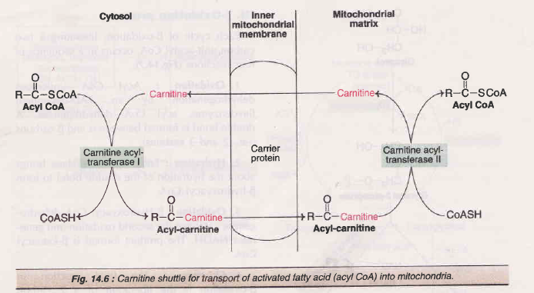
Transport from cytoplasm to mitochondria

Slide 21
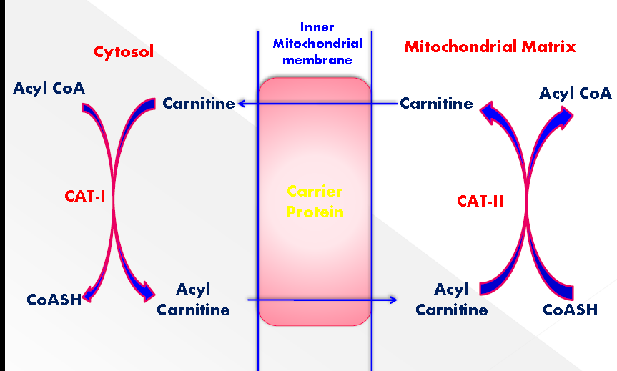
Transport from cytoplasm to mitochondria

Slide 22


Slide 23
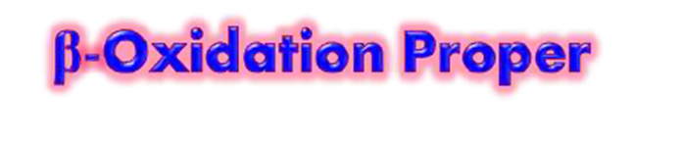
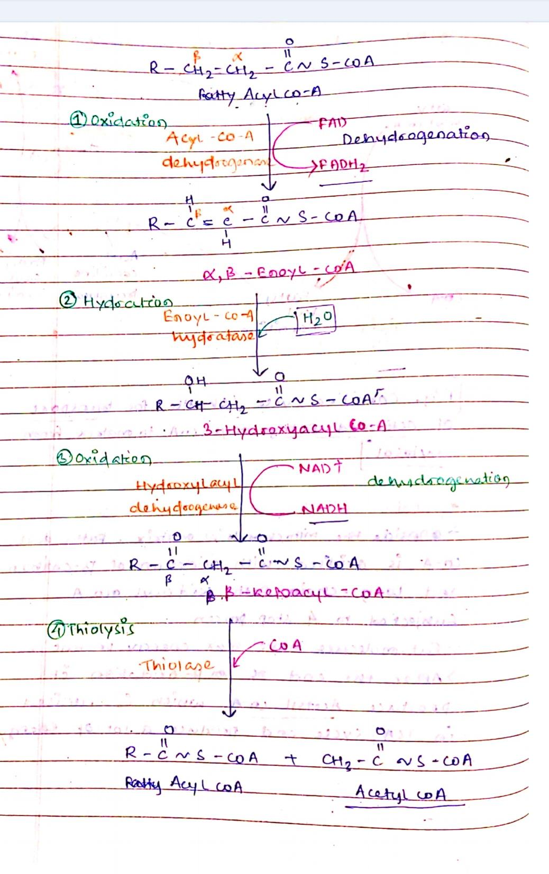

Slide 24
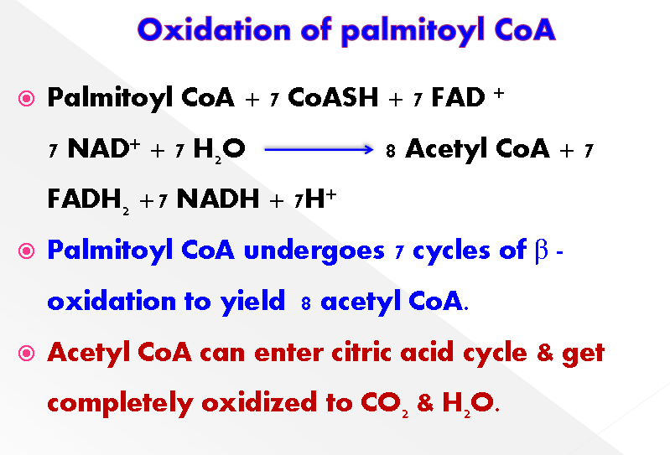

Slide 25
