Slide 1
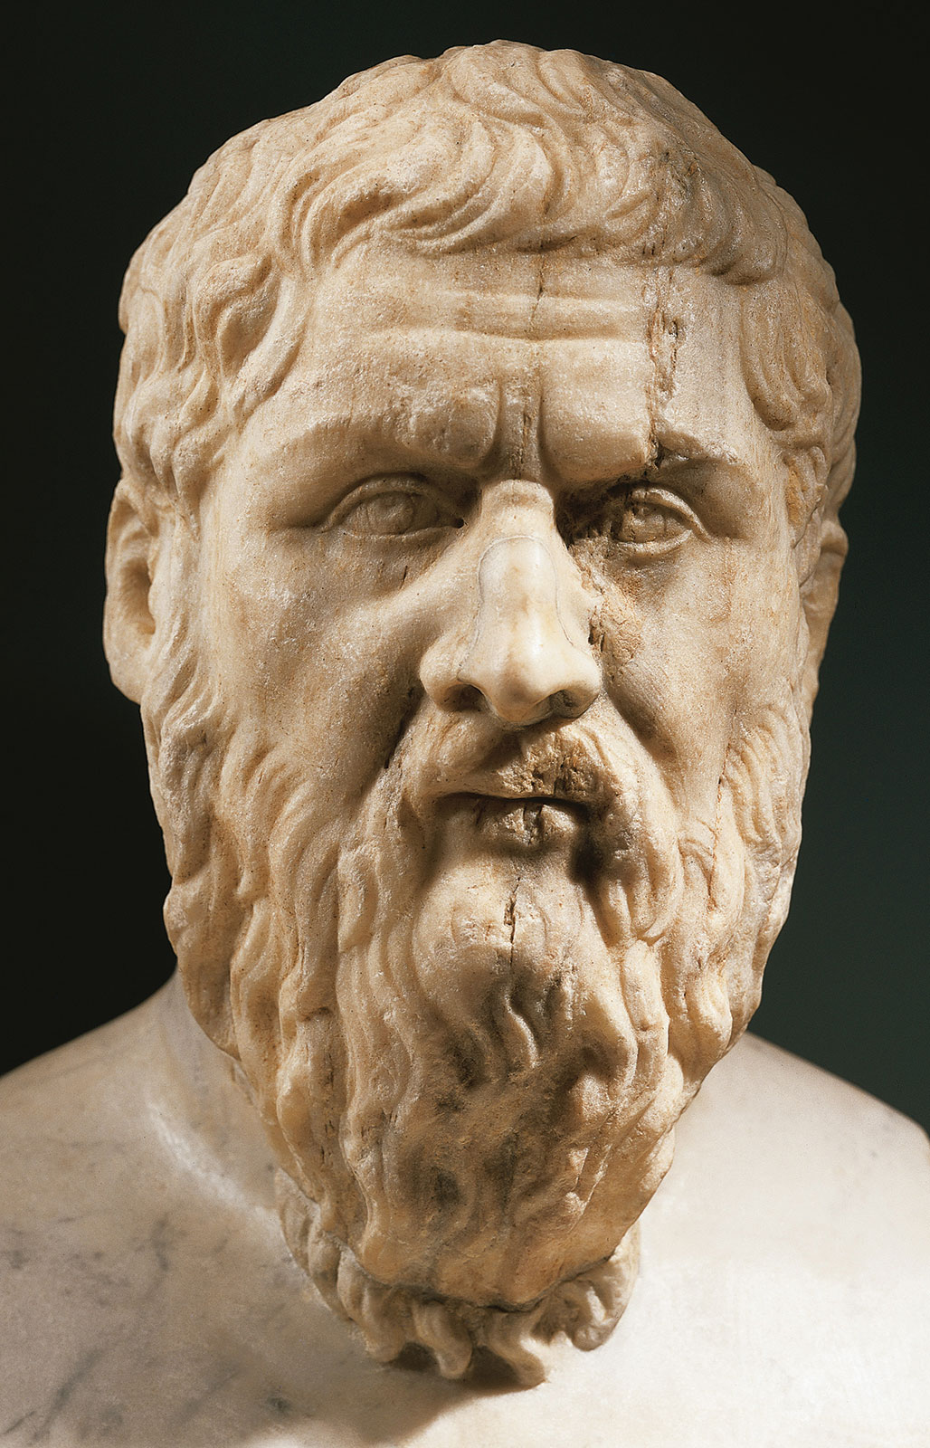
PLATO

Slide 2
A Brief History of Plato
Born in Athens in 427 BCE.
Disciple of Socrates.
Plato’s philosophy was influenced by Socrates.
Founded the Academy, to train leaders in philosophy, in Athens in 387.

Slide 3
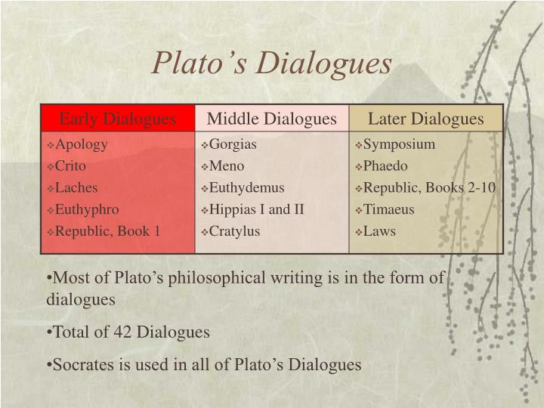

Slide 4
The Dialogue Form
Plato used the dialogue form of writing as the most effective means of presenting his philosophical ideas.
It was not Plato’s intention to answer specific question or to propose final and dogmatic solutions to any of the problems that were being discussed.
Plato preferred instead to do something that would stimulate original thinking on the part of the reader. This manner of presentation enabled Plato to present contrasting points of views as they would likely occur in a series of conversations taking place among individuals having different points of view.
Finally, by using conversational method (dialogue), it would be possible to illustrate ways in which current issues of the day were related to one another.
This is one of the reasons why none of Plato’s dialogues are devoted exclusively to the discussion of a single topic. Plato wanted to make it clear that in order to understand any particular subject, you must see how it is related to other subjects and to the field of knowledge as a whole.

Slide 5
Early Dialogues
Wrote them before he had a philosophy of his own.
Socrates is portrayed historically accurately.
Mainly critical of the moral views of others.

Slide 6
Middle Dialogues
Begins coming up with his own philosophy.
Develops some metaphysical (philosophical principles) and epistemological (nature of knowledge) positions.
Begins introducing his theory of the forms into his writing.

Slide 7
Late Dialogues
Socrates is used purely to advance Plato’s own views.
His approach is constructive—used mainly to develop his own mature philosophical system.

Slide 8
General Ideas
Inherited Socrates’s philosophy.
Attempted to complete it by adding a foundation in metaphysics.
Believed philosophy must render man morally better.

Slide 9
The Socratic Philosophy
The only real wisdom is knowing that you know absolutely nothing.
The highest good is the improvement of the soul—the care for wisdom and truth.
Virtue does not come from money, but money come from virtue.
Virtue is knowledge.
Evil and wrongdoing come from lack of knowledge or ignorance.

Slide 10
The Concept of the Philosopher-King
Plato initially thought revising the Athenian constitution would end the moral degeneration of Athens.
Then realized philosophy was the key.
Only kings that knew philosophy or philosophers that were kings would know what true justice was.

Slide 11
Plato’s Metaphysics
There is a distinction between “things” and “forms”.
This must be understood before being able to understand Plato.
“Things” are what we can perceive with our senses.
“Forms” are eternal and static.

Slide 12
HIS PHILOSOPHY
Concerned with justice, virtue, character, and the human soul.
Wanted students to become independent thinkers (think for themselves).
The only good life or life worth living is a life reasoned by your own mind, not other’s ideas and opinions; change your life and mind!
Examine your life, history, and ideas, once you self examine, then you are ready for knowledge.
All knowledge begins in not knowing. To state “I don’t know” is the first step – open to learning.

Slide 13
HIS PHILOSOPHY (CONT.)
Everything has a truth or an “essence,” your job is to seek this truth. Life is an adventure and journey, not destination.
The good teacher will spark you, lead you to the truth with integrity, reason, imagination.
Virtue is excellence, or doing your best – reaching your highest potential for good. All human’s have potential for virtue, goodness, and to shape good character.
The potential rests in the human soul (or psyche/mind), everyone born with a soul.
Character is what is developed from this soul, and is molded and tested and shaped—a dynamic process.

Slide 14
HIS PHILOSOPHY (CONT.)
Plato was the first to unify a system of thought in Western society.
We all begin with common sense beliefs, opinions, we are lead further to ideas, and principles.
Human life always involves our fellow man and our personal and societal destiny.
Philosophy is not specialized nor technical but a way of life, requiring intellectual ability and moral goodness to pursue the good and truth.
Society is our ultimate teacher, and it may produce errors and evils, as well as wrong values. Previous generation may have been wrong and transmitted bad ideas and practices.

Slide 15
PLATO’S THEORY OF KNOWLEDGE
TYPES OF KNOWLEDGE:-
CONJECTURAL KNOWLEDGE
PRACTICAL KNOWLEDGE
HYPOTHETICAL KNOWLEDGE
RATIONAL KNOWLEDGE

Slide 16
CONJECTURAL KNOWLEDGE
It is referred to the lowest type of knowledge.
Illusory knowledge.
Hallucinations, dream, false appearances.
Erroneous knowledge.
For ex-son of barren woman.

Slide 17
PRACTICAL KNOWLEDGE
Sensuous knowledge.
Knowledge through sense organs.
Knowledge of color, shape and knowledge of the world.

Slide 18
HYPOTHETICAL KNOWLEDGE
Knowledge includes numbers and forms
Mathematical knowledge
Plato’s hypothetical knowledge is referred as the mediator comes between the practical knowledge and rational knowledge.

Slide 19
RATIONAL KNOWLEDGE
Highest form of knowledge.
Knowledge of ideas, concepts and forms.
Dialectical methods needs rational knowledge.

Slide 20
Plato’s Theory of Knowledge
Plato described how the human mind achieves knowledge, and indicated what knowledge consisted of, by means of:
1) his allegory of the Cave
2) his metaphor of the divided line
3) his doctrine of the Forms

Slide 21
The Cave – General Information
Allegory from The Republic.
Socrates is talking to Glaucon, one of his followers.
Story to explain knowledge/wisdom.
Contends that we are ignorant and we are comfortable with the ignorance because it is all we know.
Seeking the truth is a difficult process.
Once you have had a taste of the truth, you never want to go back to being ignorant.

Slide 22
The Scenario
Prisoners: Men living in a large cave; chained by the leg and neck since childhood so they cannot turn their heads and can only see what is in front of them
Elevation: Behind them is an elevation that rises abruptly from the level where the prisoners are. There are other people walking across this elevation carrying artificial objects (figures of animals, humans, etc.)
Fire: Behind the people carrying the objects is a fire
Entrance: Further back is the entrance to the cave

Slide 23
The Prisoners
Can look only forward against the wall at the end of the cave; cannot see each other, the moving persons, nor the fire
Can only see the shadows on the wall in front of them which are projected as the persons walk in front of the fire; they are not aware that the shadows are shadows of other things
When they see a shadow and hear a person’s voice echo from the wall, they assume that the sound is coming from the shadow because they are not aware of the existence of anything else
The only reality recognized by the prisoners are the shadows on the wall

Slide 24
Proposition 1:
What would happen if one of the prisoners was unchained, forced to stand up, turn around, and walk with eyes lifted up toward the light of the fire?
All of his movements would be exceedingly painful
Would the objects being carried be less meaningful than the shadows seen before?
Would his eyes ache from looking at the light of the fire?
He undoubtedly would return to the things he could see with clarity and without pain, convinced that the shadows were clearer than the objects he was forced to look at in the firelight

Slide 25
PROPOSITION 2
What if the prisoner could not turn back and was dragged forcibly to the mouth of the cave and released only after he had been brought out into the sunlight?
The sunlight would be so painful on his eyes that he would be unable to see any of things he was now told were real
It would take time for his eyes to become accustomed to the world outside the cave
Would at first recognize some shadows
Would next see reflections of things in water
In time, he would see things themselves
Next, he would see heavenly bodies at night
Finally, the sun

Slide 26
Prisoner’s Conclusion
the sun is what makes things visible.
it is the sun too that accounts for the seasons and is the cause of life in the spring.
would understand what he saw on the wall in the cave; that shadows and reflections differ from things as they are in the visible world.
without the sun there would be no visible world.

Slide 27
Proposition 3:
How would such a person feel about his previous life in the cave?
He would recall what he and his fellow prisoners took to be wisdom, how they had a practice of honoring and commending each other (i.e. prizes for the sharpest eye, best memory, etc.)
Would the released prisoner still think that such prizes were worth having?
Would he envy those who received honors in the cave?
Instead of envy, would he have only sorrow and pity for them?

Slide 28
Proposition 4:
What if the released prisoner went back to his former seat in the cave?
He would have great difficulty seeing for going suddenly from daylight into the cave would fill his eyes with darkness
He would have trouble distinguishing the shadows on the wall
Those who had their permanent residence in the cave would win every round of competition with him
Those in the cave would find this very amusing and would taunt him saying that his sight was perfectly fine before and was now ruined
They would argue that it was not worth going out of the cave

Slide 29
The Allegory
The cave and the blurred world of the shadows = ignorance
The bright world of light = knowledge

Slide 30
The Allegory of Cave symbolized four grades of knowledge (Ideas)
The man in chain: Conjecture, illustrated the first grade of knowledge. The shadow and echoes are only reflection on other thing.
The man unbound in the cave; illustrated the second stage of knowledge; Belief. The direct and experimental perception of things involves a comparatively spontaneous and firm assent to whatever One sees or hear or feel, it called Belief.
The men out of Cave; Reasoning. The man leaves the cave of pre-scientific sense experience and ascend to the region of sun-clear intelligible, dionessis-reasoning.
The man fully liberated: Understanding. Man who fully free their mind from the bonds of changing sensible and of particular mathematical intelligible are ascend to the highest grade of knowledge— noesis—understanding.

Slide 31
NOESIS
Noesis-Understanding reveals to The Supreme Idea, Good, who symbol is the sun and in who intelligibility and clarity all others object participate in decreasing degrees.
Noetic vision—the mind understand reality in true perspective, realizing that Divine Ideas are the archetype of all other object, which in turn, are image of ideas or shadows of the image. The highest knowledge where the mind reason “from idea, through idea and in idea.”

Slide 32
THEORY OF IDEAS OR FORM
Plato accepted, without alteration, the Socratic theory of knowledge—knowledge according to him is neither perception, nor belief or opinion.
All knowledge is knowledge through concepts. Concepts being fixed as they are identical with definitions, they do not vary from individual to individual as opinion or perception or belief vary.
So concepts give us objective knowledge. “Knowledge is founded on reason, and reason is the faculty of concepts.”

Slide 33
THEORY OF IDEAS OR FORM(CONT)
For Socrates, concepts were mental. These help us in thinking about a whole class of particular things.
Concepts, being nothing but definitions, have only a regulative value in thought says Socrates.
We compare any animal with the definition of man in order to ascertain whether it is a man. Plato builds upon this teaching of Socrates, a new and wholly un-Socratic metaphysics of his own.
He converts Socratic theory of knowledge into a theory of the nature of reality—says Prof. Stace. As B. Russell puts it “There is, however, something of great importance in Plato’s doctrine which is not traceable to his predecessors, and that is the theory of ideas or forms.”

Slide 34
THEORY OF IDEAS OR FORM(CONT)
Plato’s philosophy was influenced not only by Socrates, but also by the philo­sophical outlook of Pythagoras, Parmenides and Heraclitus.
As B. Russell puts it— from Pythagoras Plato derived the religious trend, the belief in immortality, the other- worldliness, his respect for mathematics and also that is involved in the simile of the cave. From Parmenides he derived the belief that reality is eternal and that all change must be illusory.

Slide 35
THEORY OF IDEAS OR FORM(CONT)
From Heraclitus he derived the negative doctrine that there is nothing permanent in the sensible world.
From a combination of all these, Plato built up his own system of philosophy in which the most important part is that sense-experience does not give us knowledge.
Knowledge is only to be achieved by intellect. His theory of knowledge, lies at the basis of his Theory of Ideas.

Slide 36
THEORY OF IDEAS OR FORM(CONT)
Plato’s Theory of Ideas or Forms is partly logical and partly metaphysical.
The logical part deals with the meaning of general words. There are many animals of which some are called “cats”.
What do we mean by ‘cat’? The word ‘cat’ means something which is different from each particular cat.

Slide 37
THEORY OF IDEAS OR FORM(CONT)
An ani­mal is a cat because it has the common and essential character of catness.
Language needs these general words (like cat) to mean different classes of things, not this or that particular thing. An Idea means this class-essence.
This general word is not born when a particular cat is born, and does not die when it dies.

Slide 38
THEORY OF IDEAS OR FORM(CONT)
In fact, it is not in space and time, it is eternal.
This logical part of the doctrine is independent of the meta­physical part, which deals with the theory that the word ‘cat’ means a certain ideal cat, “the cat” created by God and unique-particular cats are copies of ‘the cat’, but more or less imperfect copies.
It is only due to this imperfection that particulars are many. The cat is real, the particular cats are appearances.
In this last book of the Republic Plato explains his theory of Ideas very clearly.

Slide 39
THEORY OF IDEAS OR FORM(CONT)
Here Plato explains that wherever a number of individuals have a common name they have also a common ‘idea’ or ‘form’.
For instance, though there are many tables there is only one “idea” or ‘form’ of a table.
Just as a reflection of a table in mirror is only apparent and not ‘real’, the various particular ‘tables’ are unreal, being only copies of the ‘idea’ Table which is the only real table and is made by God.

Slide 40
THEORY OF IDEAS OR FORM(CONT)
Plato’s Theory of Ideas is unique in the sense that his theory is the theory of the objectivity of concepts.
That the concept e.g., “man”, is not merely an idea in the mind but something which has a reality of its own, outside and independent of the mind—This is the essence of the philosophy of Plato.

Slide 41
THEORY OF IDEAS OR FORM(CONT)
Plato, thus, is both an Idealist and a Realist.
Plato is an Idealist in the sense that only Ideas are real and nothing else. Ideas only exist.
But Plato is a realist also, in the sense that, Ideas do not depend for this existence on human mind, but they are self-existent.
Plato’s Theory of Ideas is the theory of the objectivity of concepts.

Slide 42
Truth is Correspondence:
This theory is based on the view that truth means the correspondence of our ideas with facts of existence or reality.
If I see a mountain, and if there really is such a mountain, then my idea is true. But if there is no mountain, my idea is false. It is dream, or illusion or hallucination—a product of imagination, not knowledge.
Falsehood consists in having an idea which is not a copy of anything existing (real).

Slide 43
Truth is Correspondence(CONT)
Now, knowledge is knowledge of concepts.
A concept is true knowledge only when it corresponds to an objective reality.
So, there must be general ideas or concepts outside my mind. Plato gives the technical name “Ideas” to these real entities, to which our concepts correspond.
This and that particular beautiful thing have no reality. Reality belongs only to the idea of Beauty in general.

Slide 44
Truth is Correspondence(CONT)
Plato explains this point thus: there are many beautiful things.
The fresh red flower is beautiful, a young woman’s face is beautiful, the moonlight is beautiful.
All are different. Yet they are similar to each other. Our senses cannot give us this similarity, because it involves comparison and comparison is an act of the mind, not of the senses.

Slide 45
Truth is Correspondence(CONT)
So the idea of beauty is in our mind with which we compare beautiful thing and recognize them as resembling our a priori idea of beauty in our mind.
Now, either this idea corresponds to something outside us, or does not. In the latter case, our idea of beauty is a figment of imagination, not real.
Therefore this beauty exists outside the mind and is something distinct from all beautiful things.

Slide 46
Truth is Correspondence(CONT)
In this way all ideas e.g., the idea of the horse, or beauty, or justice or goodness—are real entities.
There are many horses, which are perceived by our senses, but there is only one idea horse,—as is evident from the fact that, we use one word to imply all horses.
The one ideal horse is the reality existing independently of all particular horses.
What then is the ulti­mate reality from which all else is explained? It consists, for Plato, in Ideas.

Slide 47
Truth is Correspondence(CONT)
Plato explains the extra-mental reality of Ideas in another way: Our soul is immortal; it carries its knowledge of Ideas from birth to birth.
Ideas of perfect straight line or perfect beauty were in the mind from our previous lives.
This idea of perfection is the standard by which we can judge all perceived triangles, straight lines or beautiful things as imperfect imitations or copies of the perfect Ideas corresponding to these.

Slide 48
Truth is Correspondence(CONT)
So Ideas exist independently of our minds in the realm of reality.
Due to this attachment of the soul with body in this life, those ideas are now only obscure and vague.
It is the aim of proper education to make the vague ideas of perfection clearer and clearer.

Slide 49
Characteristics of Ideas:
Ideas exist by themselves, that’s why these are called ‘substances’. Qualities depend on substances but the substance does not depend on qualities. The ideas are self-caused, self-determined, absolute and ultimate realities.
Ideas are universals. The idea of ‘cow’ is not this or that particular cow. It is a general concept of all cows.
Ideas are not things, but thoughts. Plato means by this that Ideas are not subjective ideas depending on individual minds. Ideas are objective Realities.
Ideas are the class-essences of things and beings. Definition gives us what is common and essential in a group of particulars. ‘Man’ is defined as a rational animal, so that rationality is essential for all human beings. Individual men may differ in all others respects like—height, complexion, weight etc. but they must be ‘rational ani­mals.’ This is implied in the idea of man.

Slide 50
Characteristics of Ideas:
5. Ideas are not in space and time, because if they were in space and time they could have been perceived by our senses. Ideas cannot be perceived by senses, but are only known by reason.
6. Being definitions. Ideas are permanent or unchangeable. Men may come and men may go, but the definition of ‘man’ remains the same. It is eternal.
7. Ideas are known by thought or reason alone. These are not known by intuition or sense-perception. Sense perception gives us only particular things and beings. Reason gives us the Ideas.

Slide 51
Characteristics of Ideas:
8. Ideas are many. There are different kinds of Ideas e.g. Ideas of class—’cat’, ‘man’, ‘horse’ etc., ideas of quality like ‘whiteness’, ’roundness’, etc., ideas of rela­tions like ‘equality’, ‘similarity’ etc., ideas of mathematics like straight lines, dots, circles and triangles, ideas of ideals like ‘truth’, ‘beauty’ and ‘goodness’. There are even the Ideas of ‘filth’, ‘hair’ etc.
9. Though Ideas are of many kinds, they are related to each other in a system of hierarchy. The less wider ideas are included in the wider ideas, the wider ones in still wider ideas, thus all ideas are comprehended in one absolute idea of the Good. The ideas of redness and blueness are included in the wider idea of color; the ideas of colour and taste, in the idea of quality.

Slide 52
SOUL
People’s inner, mental life was the most important thing about them.
The soul was the “real” part of the person temporarily attached to a physical body, but immortal.
The Tripartite Theory of the Soul
Reason
Emotion
Appetite
The soul was a guiding force that helped the body and the mind to work together, and the only way it could do this was with a governance of the tripartite

Slide 53
SOUL(CONT.)
Plato believed that the soul was immortal; it was in existence before the body and it continues to exist when the body dies.
Plato thought this to be true because of his Theory of Forms.
Plato thought we had such ideas as a ‘perfect circle’, not because we have seen one before or that it had been described to us, but the image was already known to us through the world of Forms.

Slide 54
SOUL(CONT.)
This theory also explained how the soul was generated; the soul already lived a life in the world of forms, a world that cannot be destroyed as the body can be destroyed.
Once you die, the soul is free for a short time before being entrapped once again in another body.
Plato was also a rationalist. He believed that you only have true knowledge and understanding of reality through reason.
The physical world is inferior, or course, to the realm of Forms. Any knowledge we have of the physical world is through our senses and is subjective and inexact.

Slide 55
SOUL(CONT.)
Plato’s idea of the soul is his dualist position, believing that body and soul are fundamentally distinct.
His theory on the soul was produced in his book Phaedrus.
In it Plato was most concerned with demonstrating the immortality of the soul and its ability to survive bodily death.

Slide 56
SOUL(CONT.)
The Tripartite Theory of the Soul marks a change in Plato's thinking about the control a human being exercises over his actions and thus his life.
In the Republic, Socrates departs from the position in the Protagoras. The soul, the Republic, consists in more than reason.
It has two parts that do not engage in the thinking that characterizes reason. The soul is thus tripartite:

Slide 57
SOUL(CONT.)
All three parts of the soul can give rise to desires.
The desire of reason stems from beliefs about what is good and what is bad.
This, however, is not true of the appetite and spirit.
The desires of these parts do not depend on any beliefs about what is good and what is bad.

Slide 58
SOUL(CONT.)
Now it is possible for someone to act contrary to his knowledge of what is good and what is bad.
This has consequences for how to understand the competency involved in living the good life.
The parts of the soul must have their proper organization. Reason must lead the way.

