Slide 1
GLOBALIZATION AND ECONOMIC DEVELOPMENT
BY
Dr Bandana Pathak
Head
Dept of Economics
S.B.Women’s Autonomous College,Cuttack

Slide 2
Globalization
This the word used to describe the growing interdependence of the world’s economies, cultures, and populations, brought about by cross-border trade in goods and services, technology, and flows of investment, people, and information.
Countries have built economic partnerships to facilitate these movements over many centuries.

Slide 3
History of Globalization
Archaic globalization conventionally refers to a phase in the history of globalization including globalizing events and developments from the time of the earliest civilizations until roughly the 1600s.
This term is used to describe the relationships between communities and states and how they were created by the geographical spread of ideas and social norms at both local and regional levels

Slide 4
Early modern" or "proto-globalization" covers a period of the history of globalization roughly spanning the years between 1600 and 1800.
The concept of "proto-globalization" was first introduced by historians A. G. Hopkins and Christopher Bayly.
The term describes the phase of increasing trade links and cultural exchange that characterized the period immediately preceding the advent of high "modern globalization" in the late 19th century.

Slide 5
Modern
According to economic historians Kevin H. O'Rourke, Leandro Prados de la Escosura, and Guillaume Daudin, several factors promoted globalization in the period 1815–1870
The end of the Napoleonic Wars brought in an era of relative peace in Europe.
Innovations in transportation technology reduced trade costs substantially.

Slide 6
New industrial military technologies increased the power of European states and the United States, and allowed these powers to forcibly open up markets across the world and extend their empires.
A gradual move towards greater liberalization in European countries

Slide 7
Economic globalization
Economic globalization
Political globalization
Cultural globalization

Slide 8
Economic globalization refers to the widespread international movement of goods, capital, services, technology and information. It is the increasing economic integration and interdependence of national, regional, and local economies across the world through an intensification of cross-border movement of goods, services, technologies and capital. Economic globalization primarily comprises the globalization of production, finance, markets, technology, organizational regimes, institutions, corporations, and people.
While economic globalization has been expanding since the emergence of trans-national trade, it has grown at an increased rate due to improvements in the efficiency of long-distance transportation, advances in telecommunication, the importance of information rather than physical capital in the modern economy, and by developments in science and technology. The rate of globalization has also increased under the framework of the General Agreement on Tariffs and Trade and the World Trade Organization, in which countries gradually cut down trade barriers and opened up their current accounts and capital accounts

Slide 9
Cultural globalization
Cultural globalization refers to the transmission of ideas, meanings, and values around the world in such a way as to extend and intensify social relations.
This process is marked by the common consumption of cultures that have been diffused by the Internet, popular culture media, and international travel.
This has added to processes of commodity exchange and colonization which have a longer history of carrying cultural meaning around the globe.
The circulation of cultures enables individuals to partake in extended social relations that cross national and regional borders. The creation and expansion of such social relations is not merely observed on a material level.
Cultural globalization involves the formation of shared norms and knowledge with which people associate their individual and collective cultural identities. It brings increasing interconnectedness among different populations and cultures.

Slide 10
Political globalization
Political globalization refers to the growth of the worldwide political system, both in size and complexity. That system includes national governments, their governmental and intergovernmental organizations as well as government-independent elements of global civil society such as international non-governmental organizations and social movement organizations.
One of the key aspects of the political globalization is the declining importance of the nation-state and the rise of other actors on the political scene. William R. Thompson has defined it as "the expansion of a global political system, and its institutions, in which inter-regional transactions (including, but certainly not limited to trade) are managed".
Political globalization is one of the three main dimensions of globalization commonly found in academic literature, with the two other being economic globalization and cultural globalization.

Slide 11
Effects of Globalisation
Positive Effects
Negative Effects

Slide 12
Positive Effects
Increased trade and investment opportunities:
Globalization has created new opportunities for countries to trade and invest across borders. This has led to increased economic activity and higher levels of economic growth.
Access to new markets and customers:
Globalization has allowed businesses to expand their customer base and access new markets, which has helped to boost sales and profits.

Slide 13
Greater efficiency and productivity:
Globalization has increased competition among businesses, which has driven innovation and efficiency, leading to increased productivity.
Spread of new technologies and knowledge:
Globalization has facilitated the spread of new technologies and knowledge across borders, allowing countries to learn from one another and adopt best practices.

Slide 14
Increased competition:
Globalization has increased competition among businesses, which has led to lower prices and higher quality products for consumers.
Potential for economic growth and development:
Globalization has the potential to drive economic growth and development, particularly for developing countries that have been able to attract foreign investment and benefit from increased trade opportunities.

Slide 15
Negative Impact
Loss of jobs and industries in some regions:
Globalization has led to the relocation of industries and jobs to countries with lower labor costs, which has led to job losses and industry declines in some regions.
Widening income inequality:
Globalization has increased income inequality between and within countries, with some countries and individuals benefiting more than others.

Slide 16
Cultural homogenization:
Globalization has led to the spread of Western culture and values, which has resulted in the homogenization of cultures and the loss of traditional cultures.
Environmental degradation:
Globalization has contributed to environmental degradation, with increased trade and economic activity leading to higher levels of pollution, deforestation, and climate change.

Slide 17
Dependence on foreign markets and investors:
Globalization has led to increased dependence on foreign markets and investors, which can leave countries vulnerable to economic shocks and downturns.
Vulnerability to global economic downturns:
Globalization has increased the interconnectedness of economies, making them more vulnerable to global economic downturns and crises.

Slide 18
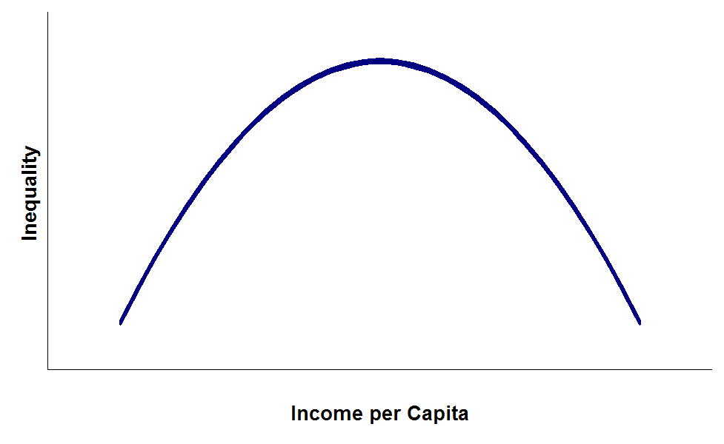
Inverted U Shaped Curve
Simon Kuznets

Slide 19
Strategies for governments and businesses to adapt to and take advantage of a globalized economy
Investment in Education and Training
Diversification of Industries
Infrastructure Development
Support for Small and Medium-sized Enterprises (SMEs)
Implementation of Environmental and Social Standards
Promotion of Foreign Investment

Slide 20
Collaboration and Networking
Governments and businesses can collaborate and network with other countries and industries to share knowledge, expertise, and best practices. This can help to improve competitiveness, access new markets, and create new business opportunities.

Slide 21
Balance the opportunities and challenges of globalization for economic development
Overall, globalization has brought about a range of both positive and negative impacts on economic development in a variety of regions and industries. Governments and businesses need to adapt to and take advantage of a globalized economy while also ensuring that they can balance the opportunities and challenges of globalization for economic development.
Balancing the opportunities and challenges of globalization for economic development is essential for taking advantage of the opportunities of globalization while also mitigating its negative impacts on society and the environment. This balance will require a comprehensive approach that addresses the various aspects of the globalized economy.

Slide 22
Governments and businesses must utilize a comprehensive approach that prioritizes inclusive economic growth, fosters innovation and technological advancements, promotes sustainable development, focuses on international cooperation, invests in education and skills development, and implements effective regulatory frameworks.

Slide 23
THANK YOU

